Slide 1
Kinematic motion models based vessel state
Authors
Date
Notes:
The Control systems and Automation Laboratory, at University of Bergamo, develops and researches in the fields of mechatronics, fault diagnosis, predictive maintenance data science and system identification.

Slide 2
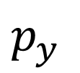
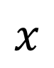
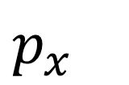
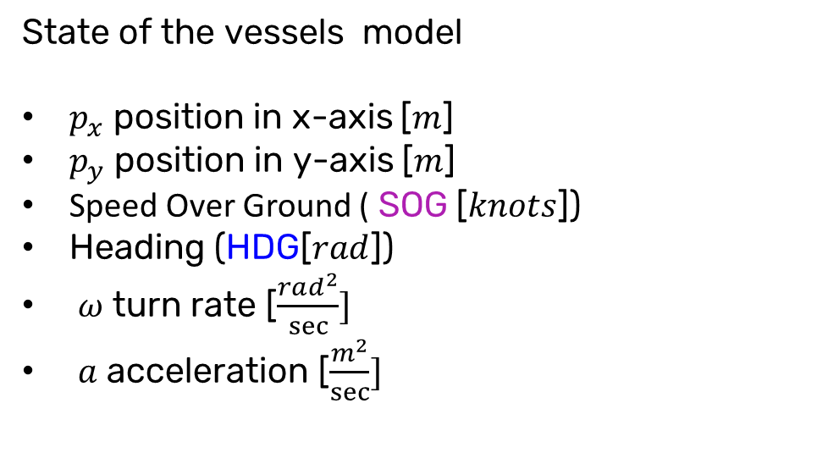
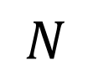
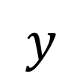
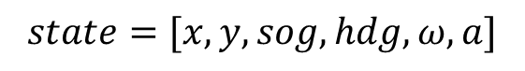
Kinematic motion models based vessel state
Course Over Ground (COG) is the actual direction of motion (the intended direction of travel).
While Heading is the direction in which a vehicle/vessel is pointing at any given moment
State of the vessels model
$p_{x}$ position in x-axis [$m$]
$p_{y}$ position in y-axis [$m$]
Speed Over Ground ( SOG [$knots$])
Heading (HDG[$rad$])
$ω$ turn rate [$\frac{rad^{2}}{sec}]$
$a$ acceleration [$\frac{m^{2}}{sec}]$
$$y$$
North direction
$$N$$
HDG
COG
$$state=[x,y,sog,hdg,ω,a]$$
$p_{y}$
SOG
Measured
Estimated
$p_{x}$
$$x$$

Slide 3
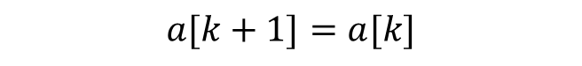
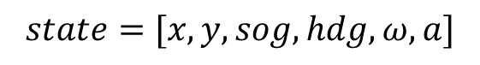
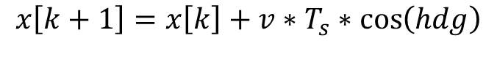
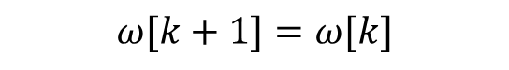
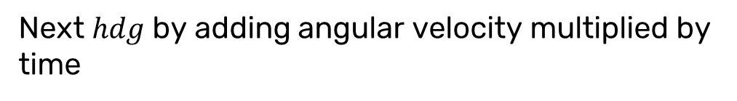
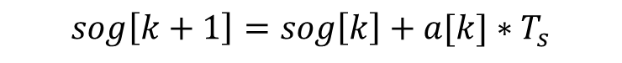
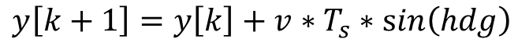
Kinematic motion models based vessel state
$$state=[x,y,sog,hdg,ω,a]$$
$$x\left[k+1\right]=x\left[k\right]+v∗T_{s}∗\cos\left(hdg\right)$$
Next $x$position using current velocity and orientation
$$y\left[k+1\right]=y\left[k\right]+v∗T_{s}∗\sin\left(hdg\right)$$
Next $y$ position using current velocity and orientation
$$sog\left[k+1\right]=sog\left[k\right]+a[k]∗T_{s}$$
Next $sog$ by adding acceleration multiplied by time
$$hdg\left[k+1\right]=hdg\left[k\right]+ω[k]∗T_{s}$$
Next $hdg$by adding angular velocity multiplied by time
$$ω[k+1]=ω[k]$$
Assuming angular velocity remains constant
$$a[k+1]=a[k]$$
Assuming acceleration remains constant
Notes:
Next x position using current velocity and orientation
Next y position using current velocity and orientation
Next velocity by adding acceleration multiplied by time
Next orientation by adding angular velocity multiplied by time
Assuming angular velocity remains constant
Assuming acceleration remains constant

